Slide 1

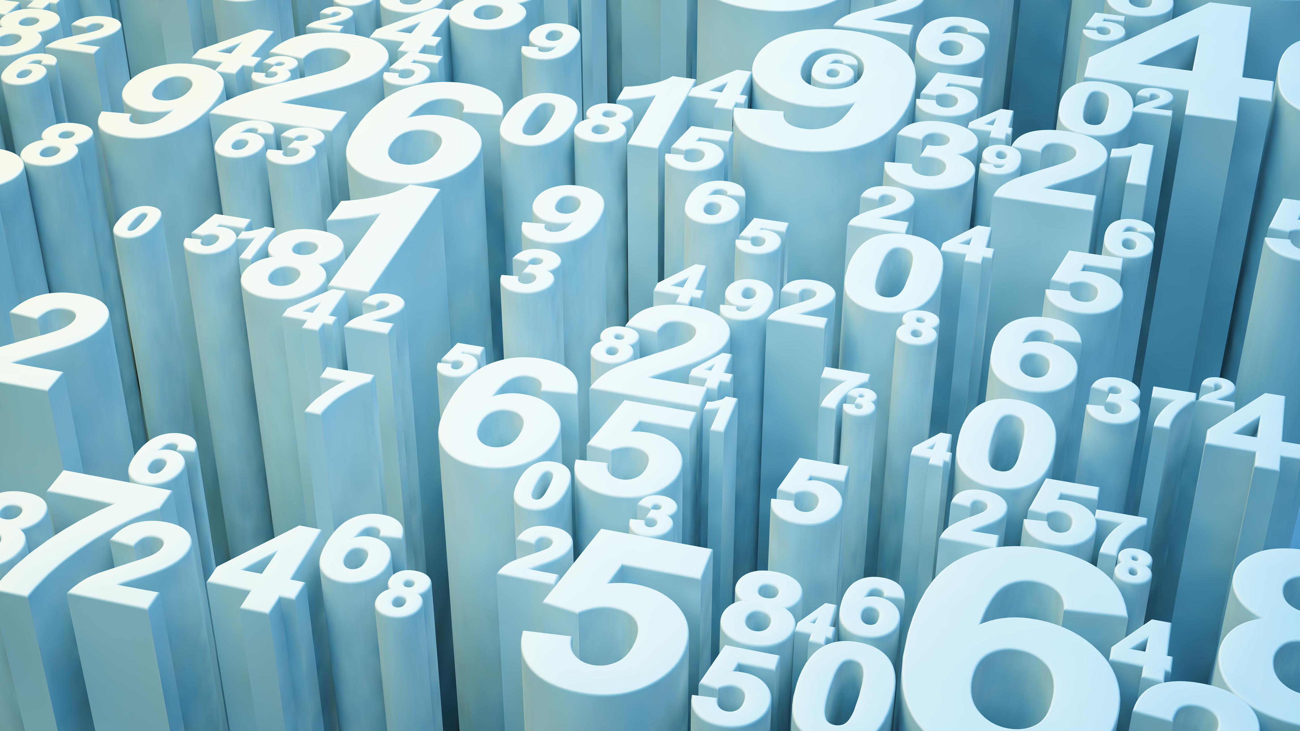
BDAT1004 DATA PROGRAMMING FINAL GROUP PROJECT Group-5

Slide 2


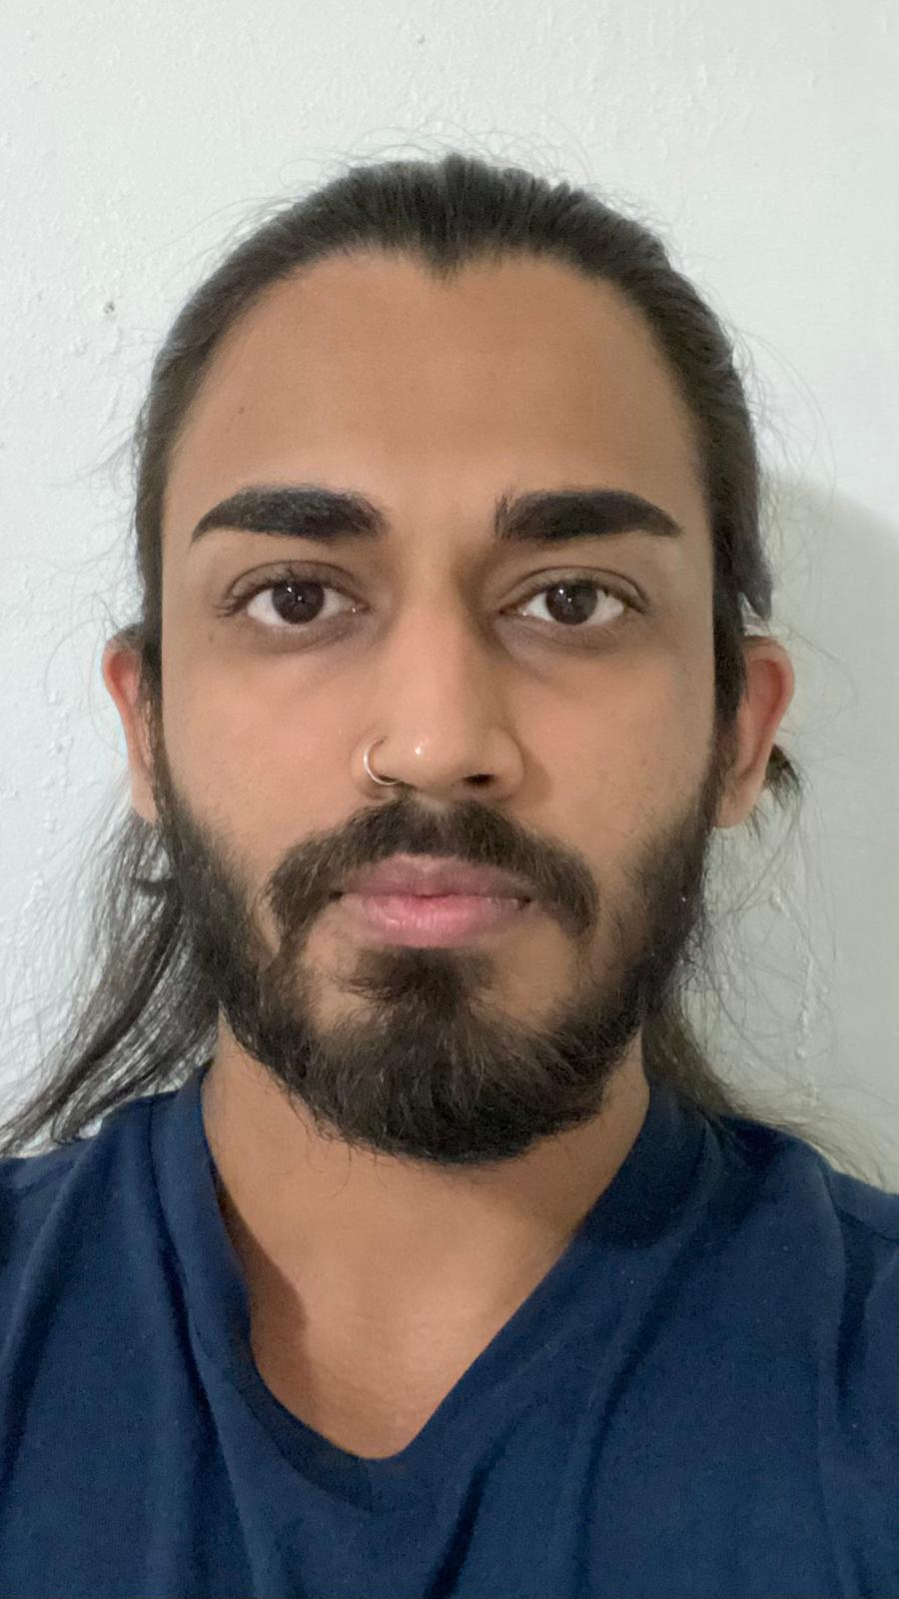

Team Profile
Ritin Patel
200556242
Business Analyst
Richie George Thomas
200573379
Data Analyst
Gokul Shrivastav
200579267
Developer
Fizaben Vahora
200579690
Project Manager

Slide 3
Project Summary
We've obtained data for 50 different cryptocurrencies by utilizing the Coinbase API link: https://api.coinbase.com/v2/prices
This data has been securely stored in MongoDB Atlas, ensuring efficient organization and accessibility.
Our website seamlessly integrates this data, providing users with up-to-date information on cryptocurrency prices.
Automatic updates occur every 24 hours, ensuring that users always have access to the latest price data for all listed currencies.
Users have the convenience of searching for specific cryptocurrencies, enhancing their browsing experience.
Visual representations of the data are available, including a line chart depicting Bitcoin's price over time, as well as two bar charts highlighting the top 5 most expensive and least expensive cryptocurrencies, offering users valuable insights into market trends.

Slide 4
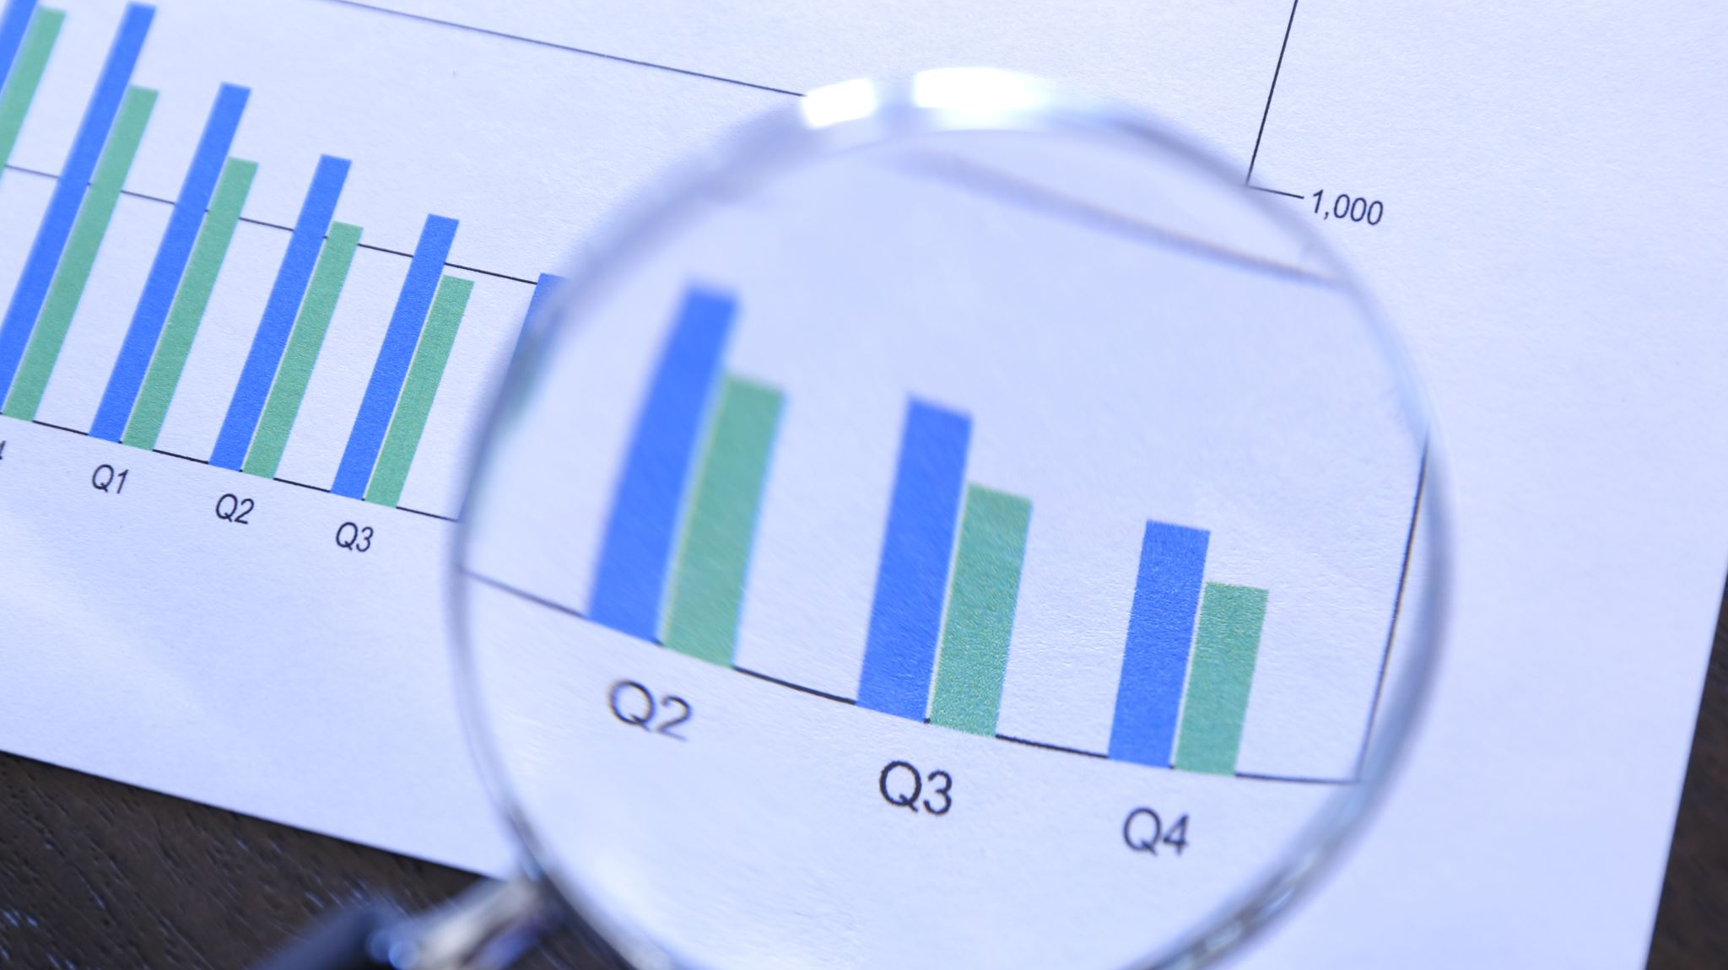
Tools and Technologies
Python
JavaScript
HTML
CSS
MongoDB Atlas
Google Charts
Web application framework - Flask

Slide 5
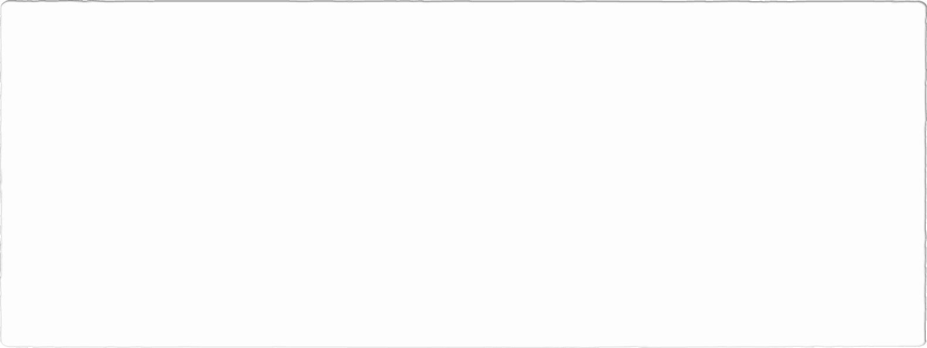
Steps for the Project
We initiated the process by fetching the data through the provided API link.
1
Following data retrieval, we proceeded to securely store it within MongoDB Atlas for effective management.
2
Next, we seamlessly integrated the stored data into our website, facilitating easy access for users.
3
To ensure the information remains current, our system automatically updates the data every 24 hours.
4
Enhancing user experience, we incorporated a search functionality enabling users to locate specific cryptocurrency data effortlessly.
5
Finally, we utilized visualization tools such as line charts and bar charts to present the data in a clear and intuitive manner, aiding users in understanding market trends and cryptocurrency performance.
6

Slide 6
Why MongoDB as database
We choose MongoDB as database to store acquired data from API.
MongoDB is an open-source NoSQL database. So, its schema-less architecture minimize the need of schema migrations and allow easy integration of diverse data types.
It is highly scalable which allows to handle large volume of data and high user loads, ensuring seamless performance.
It stores the data in flexible (JSON-like format).
Its versatility and open-source nature make it suitable for variety of application starting from small scale project to large company platforms.

Slide 7
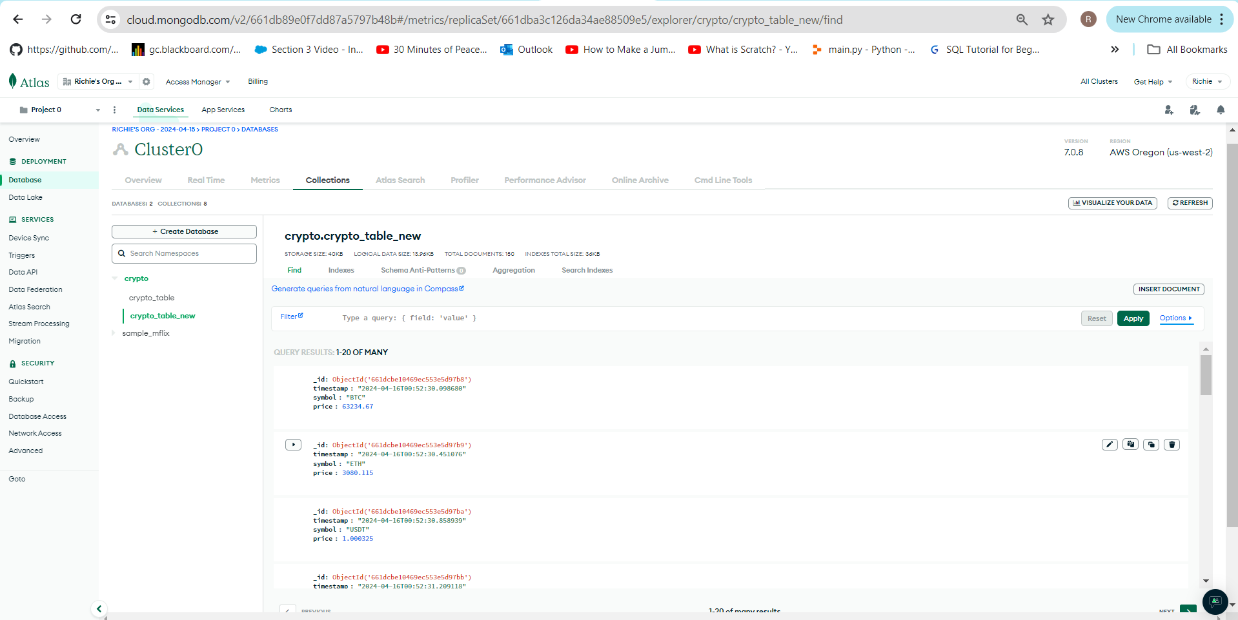
Database - MongoDB
Created account in MongoDB to store the data on live server.
Database called ‘crypto’ is created to store the data from API.
Here, crypto currency data is stored in the ‘crypto_table_new’ .
It has three fields:
1. timestamp
2. symbol
3. price (CAD)

Slide 8
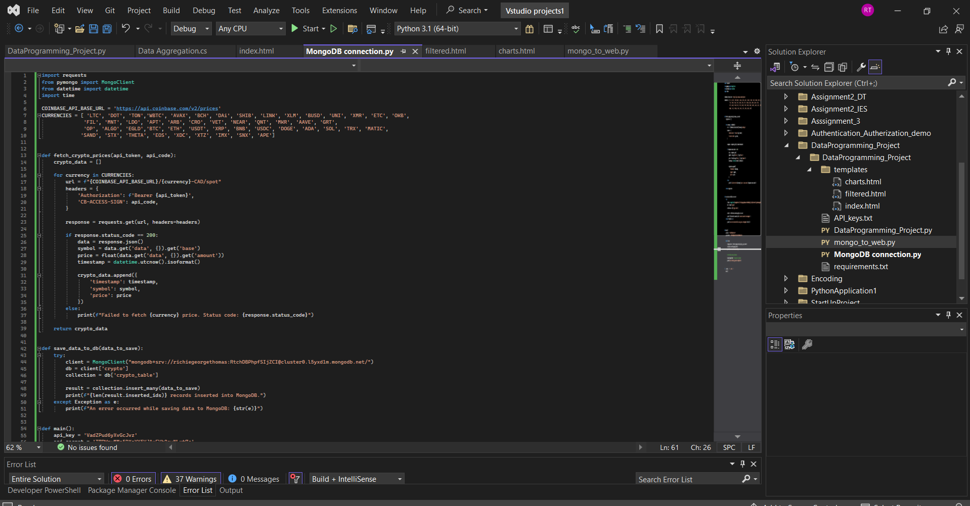
Code for Database Connection

Slide 9
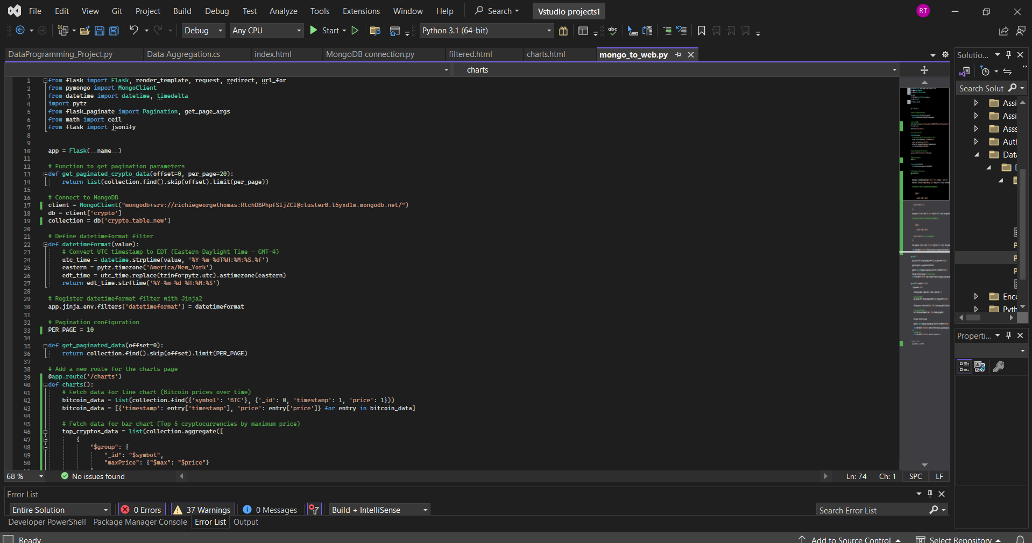
Code for Webpage

Slide 10
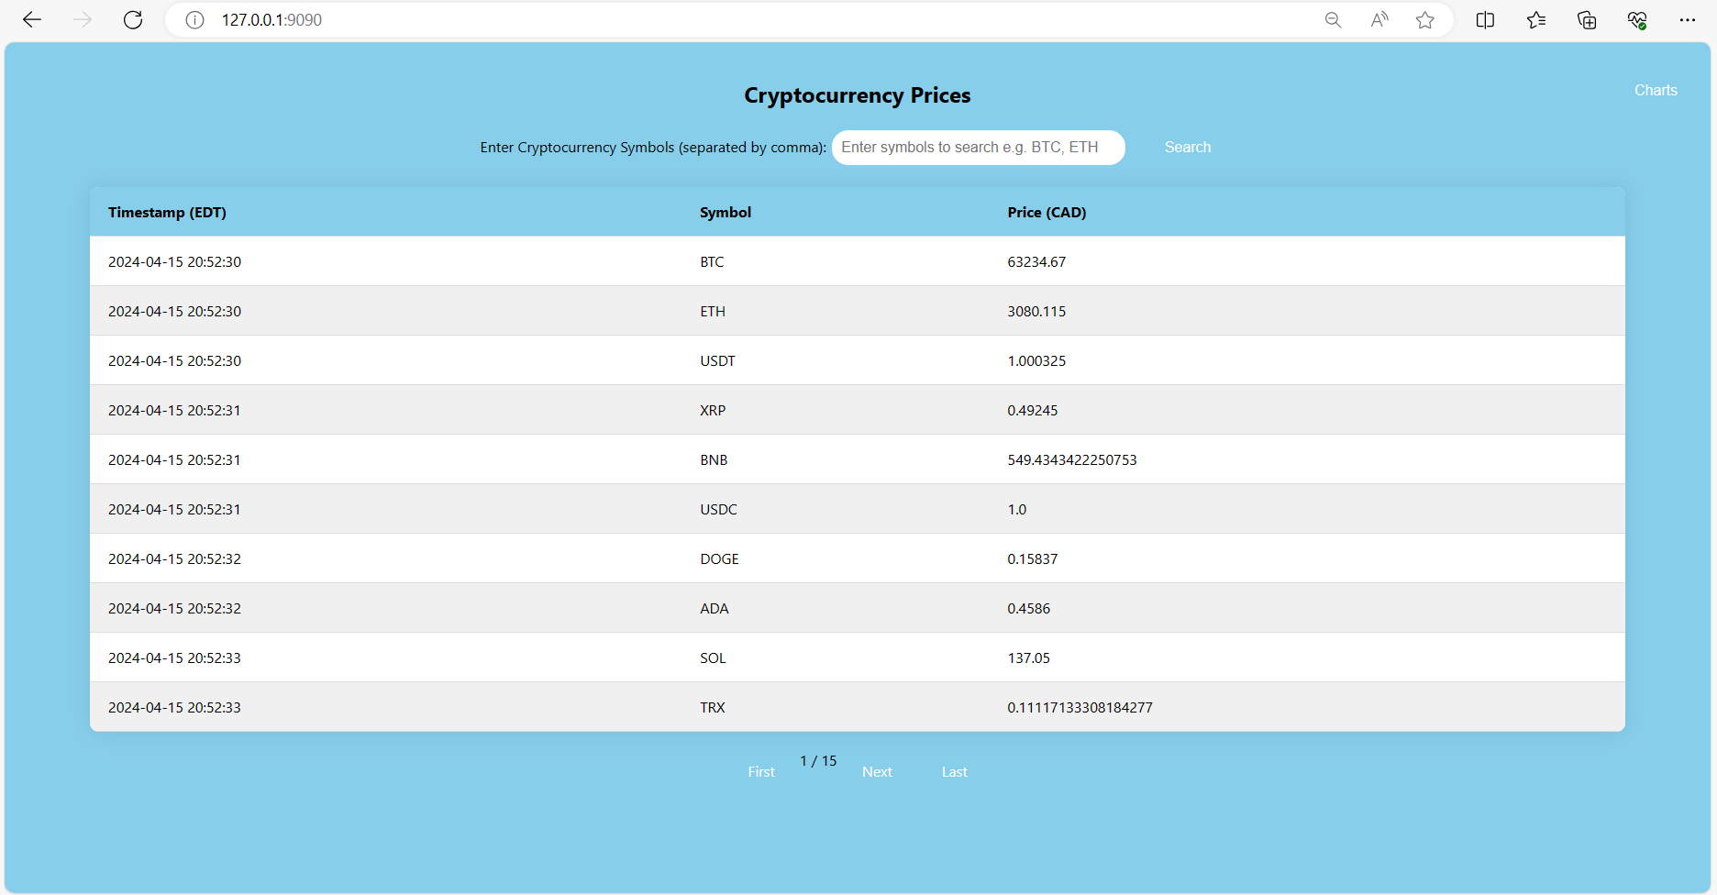
The home page shows all the timestamps as well as the price in CAD corresponding with the other currencies.

Slide 11
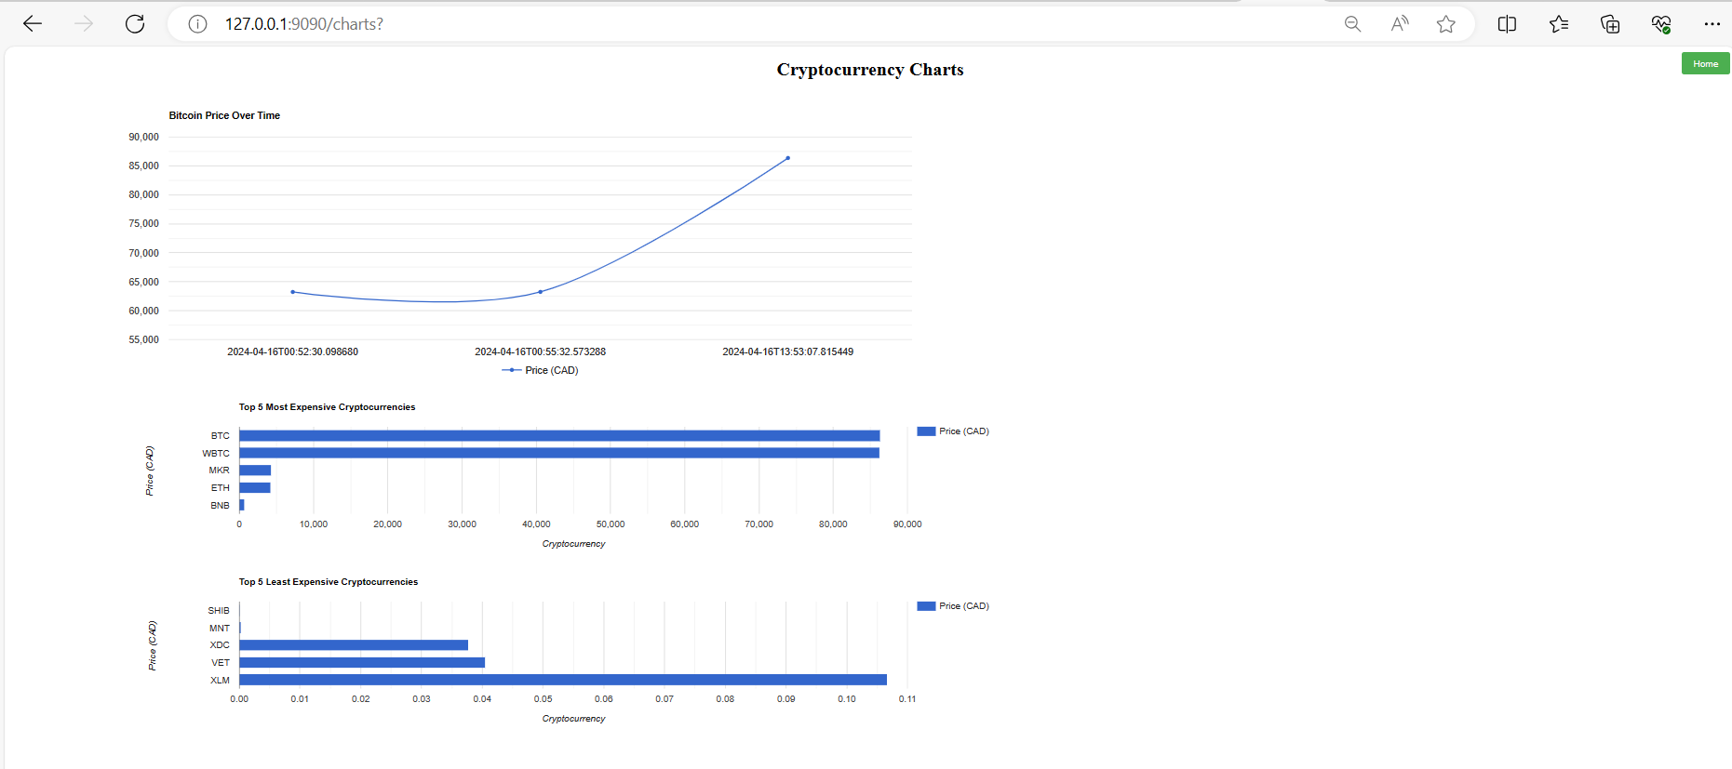
1. We have 3 visualizations. The line chart depicts Trend line of the current bitcoin price. The1st bar chart shows Top 5 most inflated currencies currently and the 2nd Bar chart show the least inflated currencies at the moment.

Slide 12
Live demonstration
Live Demonstration

Slide 13
TASK | DESIRED STAGE | CURRENT STAGE | GAP
1 | Demonstrate the acquisition of a data source from a remote source (URL) | Fetched the data from a URL API | Nil
2 | Use Python to acquire data and store into a database | Developed a python code to retrieve data and store contents into db. | Nil
3 | Use a cloud database you choose the type of database you feel is most appropriate MongoDB, Firebase, Cassandra, | Used MongoDB live server to store API data | Nil
4 | Use Python to run a pseudo-batch process that runs every 24-hours to acquire data and store in this database | Developed a pseudo-batch process to get live data every 24 hours | Nil
5 | Use a web application framework like Flask or Django, server-side code will be python | Used web application framework - Flask and server side code is developed in python | Nil
6 | Use JavaScript on the client side to display a dashboard visualization of the data using charts and graphs (for example using Google Charts | Developed a dashboard in JavaScript and used 3 visualization using Google chart | Nil
Fit Gap Analysis

Slide 14
Thank You

